Slide 1
Canada School of Public Service Digital Academy
Who we are and what we do

Slide 2
What is digital?
“Digital” is not a thing. It’s a way of doing things.
It’s about …
People
Organizations
Data
Devices
Mindsets
Processes
and …
adopting a culture that is agile; user-centric; flexible and adaptive; technology-literate; innovative; open; and that supports knowledge flow, continuous learning, and collaboration.

Slide 3
Digital is business
The reality is that every government is now a digital government, including the Government of Canada (GC).
The majority of touchpoints with governments, for the majority of citizens, is now online.
Virtually every industry that government supports and regulates is digital.
The question for government is how effectively and how consistently can we meet new and evolving digitally-driven needs.
Better decision
making
Demands
transparency
Improved
delivery
Encourages innovation
Increased
competitiveness
Greater
outreach
Droves of
data
Increased
efficiency
Instant
communication

Slide 4

The CSPS Digital Academy
A teaching organization held at the Canada School of Public Service (CSPS)
Built from a partnership with the Office of the Chief Information Officer (OCIO) and the Canadian Digital Service (CDS)
Mission to build digital skills and mindsets across the public service by empowering individuals and teams.
Supporting Canada’s Beyond 2020 principles of an agile , inclusive, and equipped workforce.
Notes:
That is, so the GC builds digital products and services that people will actually use, that work, and that cost us way more than they’re worth
So that we get policy for emerging technologies right

Slide 5





Why the Digital Academy exists
There aren’t enough skilled technologists in Canada, let alone the public sector.
All public servants have a role in the learning required.
Our current vanguard employees will need deeper and more specialized opportunities.
The GC spends $6B annually on IT and $2.7B on IT professional services: the opportunity to invest in our people is vast.
We need to completely rethink our approach and commitment to learning in government.
The state of the market: Amazon is spending $700M on re-skilling 1/3 of its workforce. IBM is doing the same. Shopify is offering a 3-month paid training program to pull experienced developers back into the workforce. There are companies who devote 20% of some employees’ time to continuous learning.
Notes:
In some cases this can make us more effective; in others, government may want to regulate or support use; and sometimes, there are entire approaches to policy and service delivery that aren’t available until we can bring technology to bear. E.g., regulatory monitoring, Canada-wide policy engagement, or using AI to clean and use massive datasets. So we teach DevOps, AI, and create space for understanding disruptive technologies.
Inspired by Government of Canada Digital Standards
Design with users
Iterate and improve frequently
Work in the open by default
Use open standards and solutions
Address security and privacy risks
Build in accessibility from the start
Empower staff to deliver better services
Be good data stewards
Design ethical services
Collaborate widely

Slide 6
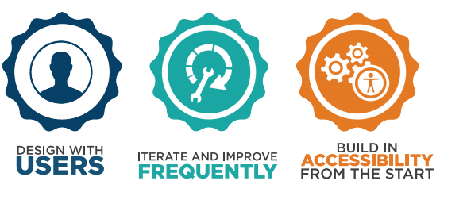
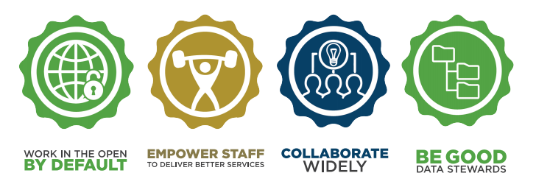

Connecting to Canada’s digital standards
At the Digital Academy, we teach learners the mindsets, approaches and tools that will support a shift towards a more agile, open, and user-focused public service that aligns with the GC’s digital standards.
Notes:
These things work. And the flipside is that if you don’t do them, government services don’t work for some people. Putting top government services through this process has raised uptake rates by 40 percentage points in some cases. [https://blog.canada.ca/2018/03/29/Visit-Canada-Optimization.html] The success rate for people finding information or application for how to visit Canada went up 27 points [. In real terms, that can be millions of people who otherwise have to call, or travel in person, go find help, or - and this happens - give up entirely.
Inspired by Government of Canada Digital Standards
Design with users
Iterate and improve frequently
Work in the open by default
Use open standards and solutions
Address security and privacy risks
Build in accessibility from the start
Empower staff to deliver better services
Be good data stewards
Design ethical services
Collaborate widely

Slide 7
A model for success
1
Creating a foundation for all public servants
At the Digital Academy, we’re working on how best to answer the questions:
Will our learning help people do their jobs?
Will our learning products help the right people, and enough of them?
The answer is a three pronged model that helps focus on individual, organizational, and systemic change.
2
Applied digital mindsets and skills for practitioners
3
How to lead in a digital age

Slide 8
Creating a foundation for all public servants
1
Busrides.ca
Digital Open Learning
Short, consumable episodes responding to government priorities
Structured learning pathways curating the best of the public, private, and social sector knowledge
Community
Events
Regular in-person and webcast events covering the spectrum of digital: upcoming events list
Digital Playbook
Discover Digital
A guide for departments and agencies to navigate the Digital Academy’s foundational offerings and other learning offerings
One day in-person course offering an introduction to digital, available across the country
Online product
In-person product

Slide 9
Applied Mindsets & Skills for practitioners
2
Premium
Integrated, practical, and multi-disciplinary in-depth learning:
1 week boot camp on foundational concepts and problem framing;
7 weeks of part-time specialized stream learning in design, data, AI/ML, development, and DevOps; including problem-based and peer learning through weekly learning circles; and,
2 weeks of full-time practical experience living digital best practices and building a product.

Slide 10





2
Premium learning streams
Leadership:
range of non-expert leadership topics (e.g. digital standards, user-centered design).
Data:
skills and tools required to conduct analytics, develop and test hypotheses, visualize and share reproducible results
Design:
skills related to techniques and tools used in user experience research and service design in a digital age
Artificial intelligence and machine learning: practical experience in developing and using algorithms to learn from and make predictions or decisions based on data
Development:
tools for modern day development including: object oriented programming, web development, and application deployment
DevOps:
practice of development (Dev) and operations (Ops), grounded in agile principles, to work through the entire service lifecycle (development, implementation, support)
Specific training for participants’ leadership
5

Slide 11


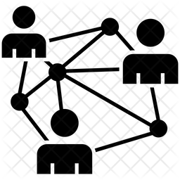




Learning Journey: Premium Cohort 2
2
Online Learning
Digital team
Problem framing
Solution Development
Demo Day
Individual Specialized Learning
Interested individuals (with problems)
Problem Exploration (Individually/Groups)
Newsletters
Slack
Transition Playbook
Learners Feedback
Departmental Engagement
Weekly
learning circles
Advisors
Mentors
Coaches
Blended learning (classroom/interactive)
Intake
Bootcamp
(1 week)
Learning
(7 weeks P/T)
Practicum
(2 weeks)
After Care

Slide 12

How to lead in a digital age
3
Enhancing digital literacy and leadership skills to change the way we work in the rapidly changing policy and service delivery landscape.
Premium Program:
Executive Community:
Linked to Premium participants’ leadership
Leading agile and multidisciplinary teams, and product ownership for participants’ home organization leaders.
Insight into the current digital landscape, digital transformation, and the role of executives in this change
Senior Leaders:
For all leaders:
Project Sponsorship and governance in agile environments.
Ongoing digital acumen series of
events.
Notes:
What is the new executive course?
Gentle guide for digitals

Slide 13

After Care: Supporting the learner’s transition
“
Communities
Departmental Engagement
Transition/
Organizational Support
After Care is all about keeping the learner connected, empowered, and inspired to keep on learning, while supporting a successful transition back into organizations following DA learning activities.
Communities of Practice
Shared resources
Learner experiences shared within and outside home organizations
Transition playbook (reintegration)
Continuous learning
Networking/
Events
Feedback
Communications
”
Mentoring
Coaching
Job shadowing
Hackathons
Learners feedback
Interviews
Iterations review
User stories
Newsletters
Learner showcases
Resource sharing
GCConnex/Collab
#GCdigital news
Insights gathered through After Care will be used to measure success and identify gaps in future programming.

Slide 14
Learning by doing in the Digital Academy
Please add a slide on Digital Innovation Services - learning for Cloud, APIs, case studies on new technology, etc
Generating learning artifacts & meeting business needs through experimentation with new tools and technology
Current Research & Development Projects
Data & APIs
Registhor, API for CSPS AWS cloud database
Regularly downloads data from the CSPS data warehouse to improve data analysis and support other projects
Real-time analytics & data-based decision making
Cortex, a mobile, cloud-based big data analytics and mining tool
Shows key performance metrics to facilitate evidence-based decision making and executive-level oversight into activities
Provides data in milliseconds, handles millions of records and relationships, can stream data to visualizers
Accessibility, usability & low-bandwidth data collection
Evalhalla, an easy-to-use, customizable survey using big data tools
Rapidly build branded accessible and mobile surveys
Auto-generated dashboard and view survey results instantly

Slide 15
Digital Academy at a glance 2019-2020
Foundations
Leadership
Premium/
Practicum
Events
Communities and Engagement
LEGEND
Bus Rides
Discover Digital (DD)
Digital Open Learning (DOL)
September 2019
October 2019
November 2019
December 2019
January 2020
2020
Busrides.ca
DD: Soft-Launch internal to CSPS
DOL: Soft-Launch
Jan. 6 – 21:Practicum
February: Digital Government Transformation and Policy Consideration
DD: External launch outside CSPS
Intake Premium Cohort 3
Jan. 22: Demo Day
Amazon Web Services for Senior Government Leaders
Building Digital Acumen
DOL: External launch
March: Privacy in the Digital World
Timelines
Premium Leadership: Targeted Agile Framework, Leadership and Product Ownership for participant’s home organization leaders
Jan. 13 - 14: DA Hackathons
Cyber security/Security Resilience
Aug. 29 – Oct. 11: Intake for Premium Cohort 2
Preparatory Activities
Oct. 28 – Nov. 1: Bootcamp
Nov. 5 – Dec. 20: Coursework
Nov. 26: Annual Digital Open Government Forum on Digital Disruption
Digital Governance: The Role of Government in a Digital Age
Premium Cohort 3
Communities and Engagement: public engagement and communications, meetups, newsletters, and after care
Notes:
Note blackout period from September 3 to October 21 due to elections.

Slide 16
How to get involved
SHARE
BusRides.ca: short, consumable digital learning
Information about the
Tell us about your skills gaps, training needs, and research
1
Digital Academy
Tell us
PARTNER
Invite us to your management table
Formal partnerships through MOUs
Develop case studies with us based on your digital change projects
2
with us
BUILD
Collaborate on and re-use Digital Academy learning resources for training
Teaching, mentoring, SMEs, coaching
3
learning resources
Notes:
Digital Foundations
A variety of learning opportunities to raise digital awareness and literacy for public servants.
Combination of original content, third part solutions and community interactions.
Learners will have access to material of a variety difficulty levels.

Slide 17
Governance and Partnerships
Steering Committee
Treasury Board of Canada Secretariat
Innovation, Science and Economic Development Canada
Canadian Digital Services
Statistics Canada
University of Ottawa
Institute on Governance
Partnerships
Shared Services Canada
Public Services and Procurement Canada
Immigration, Refugees and Citizenship Canada
Employment and Social Development Canada
Department of National Defence
Transport Canada … etc.

Slide 18
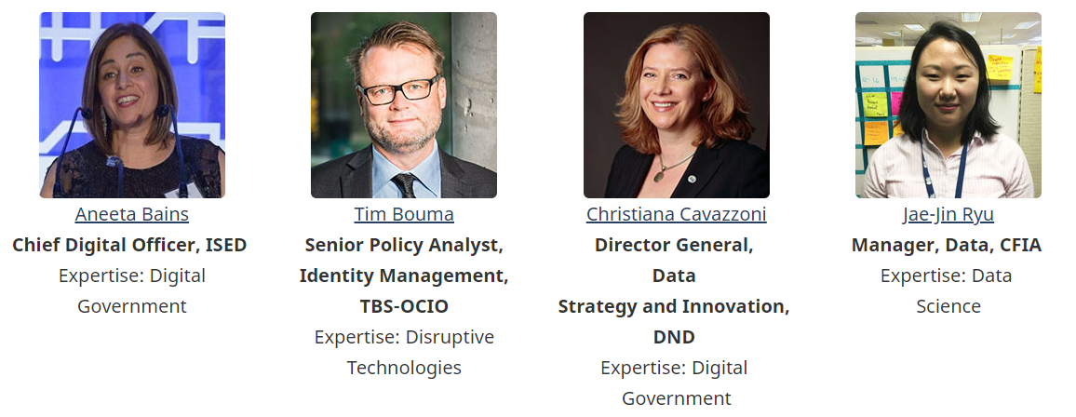
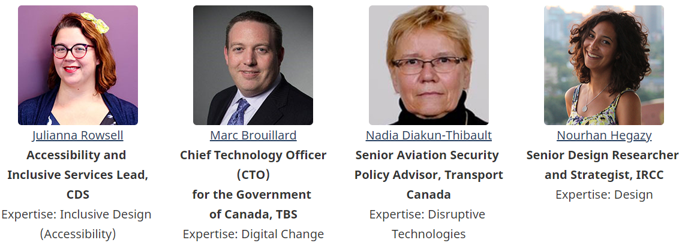
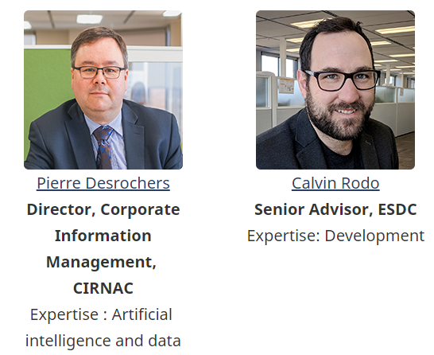
Digital Fellows
The Canada School of Public Service's Digital Fellowship aims to bring together a multi-disciplinary community of leaders to help develop and steer the Digital Academy’s learning programs. This will help ensure the academy's work meets the government's needs, and showcases the Government of Canada's most forward-looking projects and organizations.
Three Fellows to be announced November 2019
Leading Canadian experts on design, data ethics, and digital inclusion
Internal Fellows
External Fellows

Slide 19
Ten things you can do to be digital today
1
2
3
4
5
Start watching busrides.ca
Start doing a daily stand-up
Organize a focus group or user testing session for your next product / service release
Use a communications or project management tool
Organize a retrospective for a recent project and iterate
6
7
8
9
10
Organize a sprint for your next project
Visualize your work to be transparent and work in the open
Record the start and finish times of all items to have simple metrics
Take a course to enhance your learning on terminology, processes, or tools
Attend a Digital Academy or digital-related event
Notes:
3) Download a communications or project management tool (Slack, Trello, Asana, Airtable - should all be whitelisted)
4) Organize a retrospective for a recent project and iterate (e.g., download FunRetro)

Slide 20

Stay connected
Newsletter: http://eepurl.com/gdiUTH
Web: www.busrides.ca
Email: csps.digitalacademy-academiedunumerique.efpc@canada.ca
Twitter: @DigiAcademyCan

Slide 21








Annex: Digital Academy direction and curriculum
Departmental analyses and needs
Canadian Digital Service training needs analysis
Beyond 2020:
equipped, agile, inclusive
International best practices and comparators
Academy planning
CSPS research and leadership
Chief Information Officer of Canada direction
Government of Canada data strategy
Government of Canada policy direction
21
Notes:
Digital academy direction and curriculum
Academy planning consists of:
Departmental analyses and needs
Beyond 2020: equipped, agile, inclusive
CSPS research and leadership
Government of Canada data strategy
Government of Canada policy direction
Chief Information Officer if Canada direction
International best practices and comparators
Canadian Digital Service training needs analysis

